Slide 1
Chapter 45. The Nature of Light
(光的本质)
Prof. Fang Minghu
Department of Physics
Zhejiang Univeristy
Tel: 0571-87951913
Email: mhfang@zju.edu.cn

Slide 2
45-1 Introducing The Photon
(光子概念的引入)
Interference (干涉), diffraction (衍射)……
wave-like
Black-body radiation (黑体辐射), Photoelectric Effect (光电效应),
Compton Effect (康普顿效应)…..
Particle-like
Light is both a particle and a wave (光既是粒子又是波).
Light is neither a classical particle nor a classical wave.
(但不是传统的粒子也不是传统的波)

Slide 3
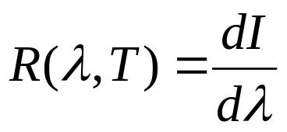
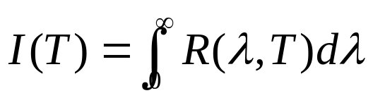
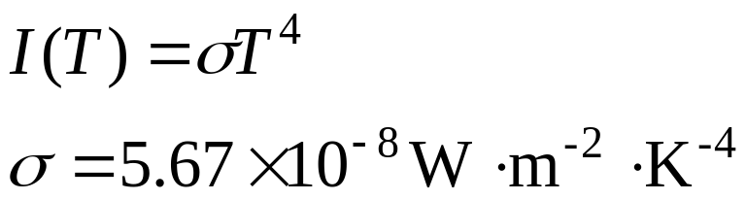


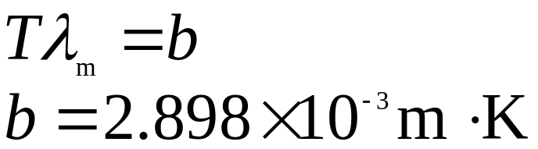

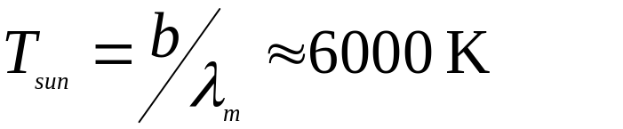
45-2 Black-Body Radiation
(黑体辐射)
Stefan-Boltzmann law
—The total radiated energy per area:
Wien displacement law:
increasing T
With a λ_{m} of 500 nm for sun radiation, the temperature of sun:

Slide 4
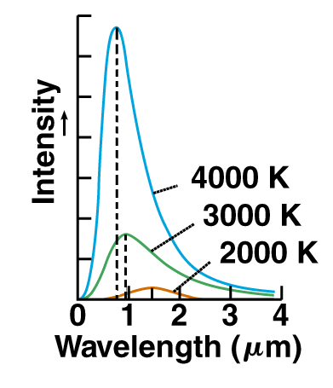
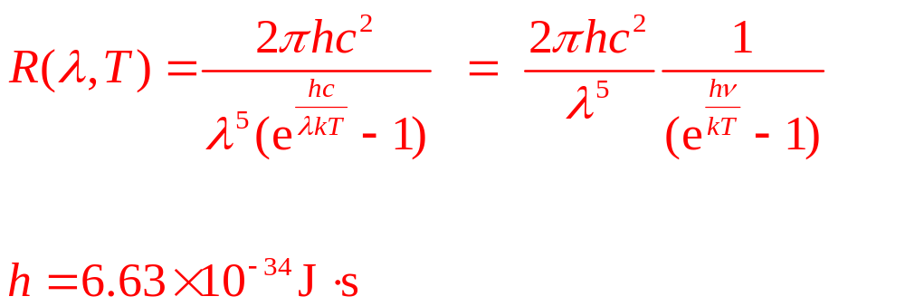
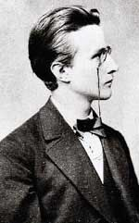
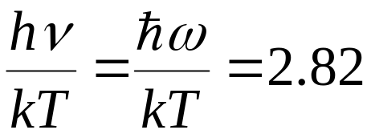

Planck’s Radiation Law
(普朗克辐射定律)
Wien’s line at short wavelength:
Reyleigh-Jeans line at long wavelengths:
Planck’s Law (1900):
Wien’s Law:
Born in 1858

Slide 5
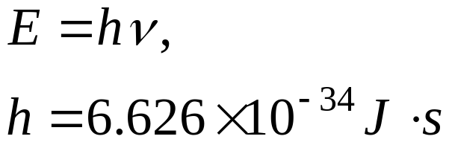
Planck's function fits the observed data
Max Planck assumed energy of photon is quantized.
The beginning of quantum physics.
1905, Einstein introduced the photon
Planck(1918), Wien(1911) Noble Prize

Slide 6
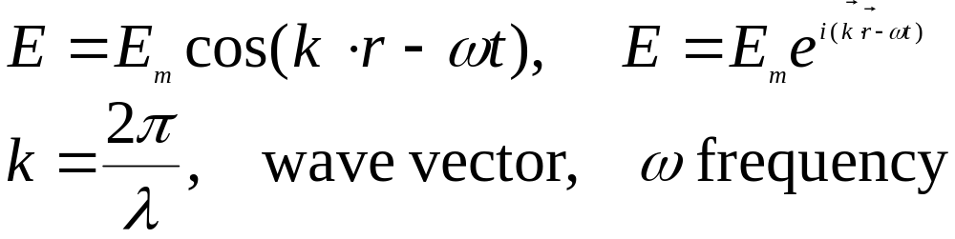
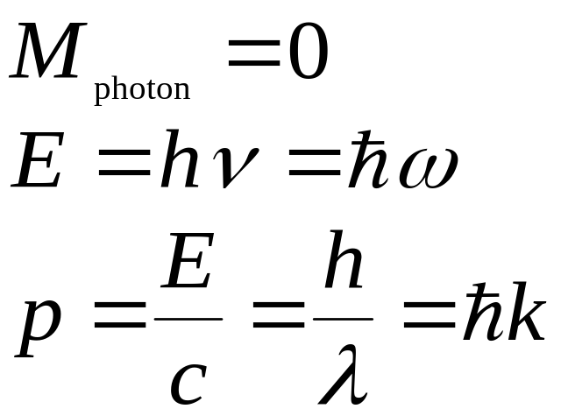
Feature of Photon (光子的性质)
Wave feature of light:
Photon—quantum of light:

Slide 7
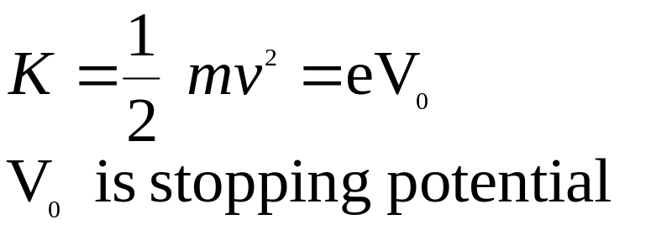

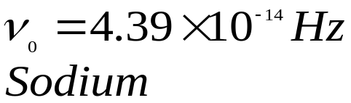

45-4 Photoelectric Effect
(光电效应)
Kinetic energy:
light
0
V
e
Problems facing to classical physics:
1. Intensity problem
2. Frequency problem
3. Time delay problem
metal
metal

Slide 8
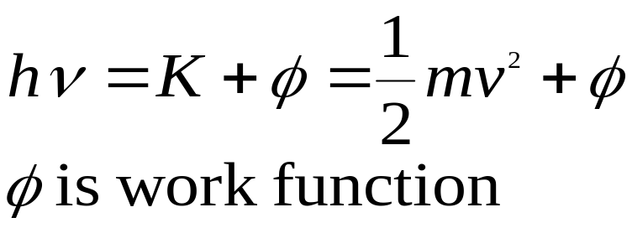
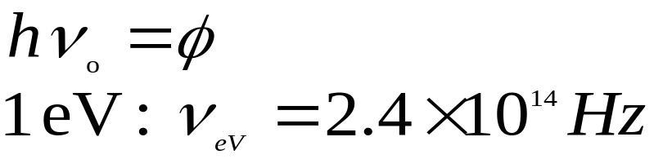
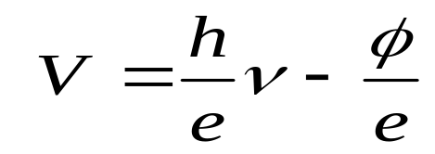
Einstain’s Photon Theory
(1921 Nobel Prize)
Quantum of light (later comes photon) was first introduced by Einstain
Cutoff frequency:
Relation between stopping potential and frequency:

Slide 9
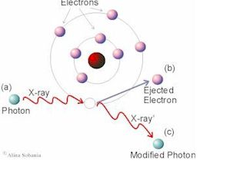
45-5 Compton Scattering (1923)
The 1927 Nobel Prize, see Page 1021

Slide 10

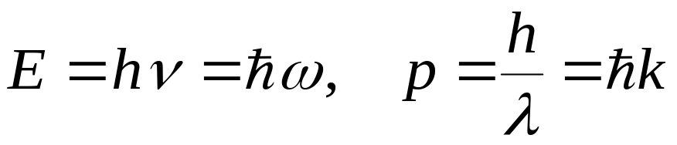




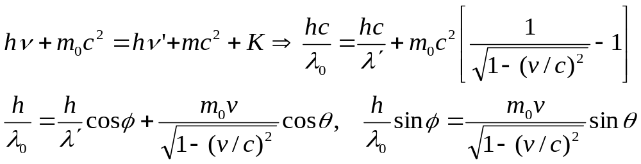
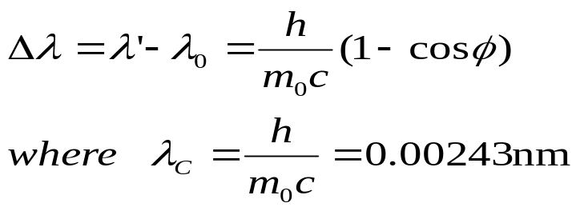
Explanation
Photon is already particle:
Scattering by electron:

Slide 11
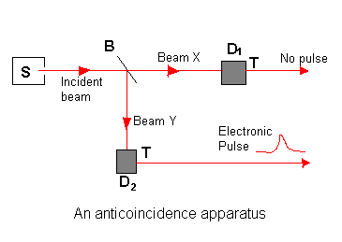
45-6 The Photon Revealed (1974, 1986)
An experiment that not only supports the photon concept but that cannot also be explained by the wave concept. (1974, J.F. Clauser)

Slide 12
Using Designated Photons(1986)
Early experiments (1974), due to the small fluctuations, it is not yet a convincing test for the presence or absence of photons.
In 1986, P. Grangier et al made chief modification for source S:
Ca+Laser bombardment

Slide 13
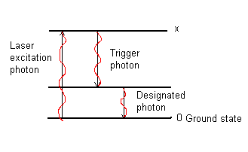
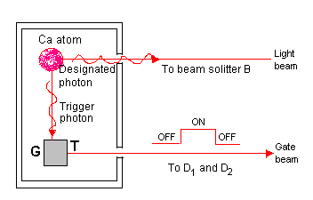
See Page 1024 Fig.45-12,
Light is “Wave” or “Particle”

Slide 14
45-7 Slowing Down Atoms by Photon Bombardment
To measure the properties of any object it is usually easiest to do so when the object is not moving.
For example, in Problem 45-5, at 300K, the root-mean-square speed of an atom v_{rms}=(3kT/m)^{1/2}=430m/s faster than a commercial jet plane. If v_{rms}↓, T↓
The atoms can be slowed down from these high speeds by being bomdarded with photons. This will provide further direct and convincing experimental evidence of the validity of the photon concept.
Steven Chu(朱棣文) et al shared the 1997 Nobel Prize in Physics “for development of method to cool and trap atoms with laser light”.

Slide 15
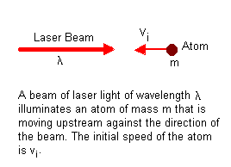
How atoms can be slowed down by being bombards with photons

Slide 16
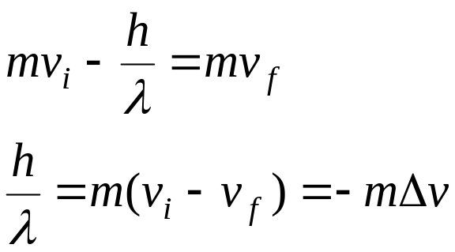

Conservation of momentum for the photon-atom interaction
Where △v, a negative quantity, is the change in speed of the atom after it has absorbed the photon. △v～a few cm/s, about the speed of a running insect.
So the the absorption of a single photon can change the speed of an atom, but not by much. To reduce the the initial speed of the atom substantially, we must illuminate the atom with a very intense laser beam so as to bombard it over and over again with photons.

Slide 17
Homework
Page 1031 (Exercises) 11, 12, 32,
Page 1032 (Problem) 5, 6

